Slide 1
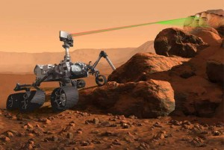
OptoSigma provides advanced Optics for NASA’s new Mars Rover
OSE is supplying beam splitters to the development of SuperCam, a remote sensing instrument for the Mars 2020 mission to the red planet.
The NASA mission to Mars in 2020 will send the Mars Rover up to look for natural resources, inspect for hazards and investigate general habitability of the planet in preparation for future human expeditions. The Rover will be equipped with advanced instruments including the SuperCam, which uses remote optical measurements and laser spectroscopy to examine the composition of samples taken on Mars.
OptoSigma Europe SAS is contributing to the development of SuperCam. Among other suppliers, OptoSigma has been selected to provide different optical elements, such as advanced beam splitters for selecting specific wavelength ranges and directing them to the different sensors of the instrument.
The SuperCam is the result of a cooperation between teams led by the Los Alamos National Laboratory (LANL, New Mexico, US) and the Astrophysics and Planetology Research Institute (IRAP, Toulouse, France). IRAP and a consortium of six French laboratories will supply an optical and electronic unit plus spectrographs, to be mounted at the top of the rover mast. The Mars 2020 rover will be launched in July 2020 and will land 7 months later. Surface operations are scheduled to last until August 2023.
The instrument will use remote optical measurements and laser spectroscopy to determine fine-scale mineralogy, chemistry, and atomic and molecular composition of samples encountered on Mars. To enable these measurements, SuperCam is, in fact, many instruments in one. For probing elemental composition, it integrates the remote Laser Induced Breakdown Spectroscopy (LIBS) capabilities of the highly successful ChemCam instrument included in the payload of the Curiosity rover currently exploring Mars. LIBS uses a 1064-nm laser to investigate targets up to 7 m distance from the rover.
SuperCam in addition performs Raman spectroscopy at 532 nm to investigate targets up to 12 m distance from the rover, Time-Resolved Fluorescence (TRF) spectroscopy, Visible and InfraRed (VISIR) reflectance spectroscopy (400 – 900nm and 1.3 – 2.6 μm) to provide information about the mineralogy and molecular structure of probes from rocks on Mars. It will also be able to search directly for organic materials.
Further, SuperCam can acquire high-resolution images of samples with a remote colour micro-imager (RMI). Measurements can be rapidly obtained without the need to position the rover or rover arm on a target. As demonstrated by ChemCam, the SuperCam laser can be used to “blast off” dust from surfaces at a distance enabling a better look at solid surfaces on Mars, without having to drive up to samples and perform manipulations with the rover arm or associated tools.

Slide 2
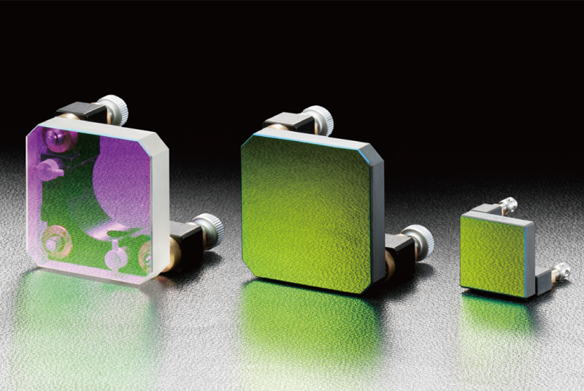
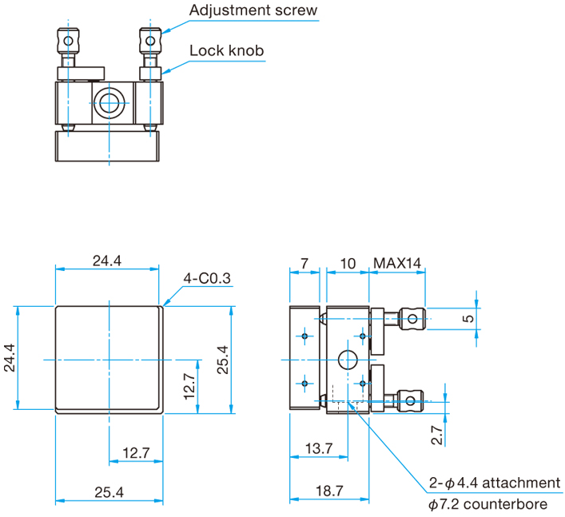
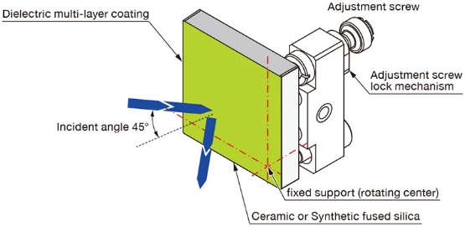
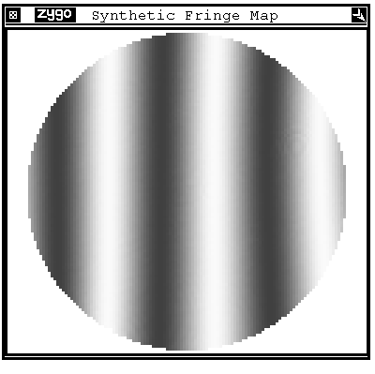
Frameless Mirror Unit – now also with Fused Silica substrates
More space for you, no stress for the optics and with integrated precision holder and adjustment - can also be used at grazing incidence!
The major source of problems with traditional optical mirror mounts comes from the metallic frame: mechanical and thermal instability, stress, limited clear apertures, etc. … We decided to design and realise a “frameless system”, where the optics are fully integrated with the structure, getting rid of all the issues above at once.
No stress and full use of the optical surface!
Instead of a frame, the frameless mirror unit is done by depositing a multilayer coating directly onto the substrate that constitutes the main body of the holder. Like a more traditional unit, of course, the frameless mirror unit is also adjustable through the use of two screws mounted on the back of the unit.
The first release of the product was based on substrates made of ceramic, which has great thermal performance. Now we introduce also a Fused Silica version, which allows a more affordable price while keeping the other advantages.
Material Fused Silica - size 24.4 x 24.4mm
3 adjustable axes with ±3° range and 0.74°/rotation
Surface accuracy after coating λ/4 guaranteed
Clear aperture coating area > 23 x 23 mm
AOI 45±3°
LDT 28 J/cm²@1064nm
Frameless mirror measured with Zygo interferometer
Product number:
GMMUHPQ-24.4-4-xxx for xxx nm laser wavelength

